Slide 1
What does the internet say about you?
Andrew Heiss
Andrew Young School of Policy Studies
Georgia State University
July 16, 2020

Slide 2
Plan for today
Why care about an internet presence?
Tell people you exist
Show people who you are
Show people what you do

Slide 3
Why care about an internet presence?
Notes:
Academia is based, in part, on reputation. Showcase your reputation
77% - some really high % of employers google candidates – you need to be found by employers
Open science – your stuff should be more accessible by the public
Community – don’t feel so alone, find potential collaborators, get more exposure (boost citations! https://www.sciencedirect.com/science/article/abs/pii/S0003497520308602)

Slide 4
It’s nice to be known
Reputation is crucial in academia
Hiring
Promotion
Networking
Citations

Slide 5
Control the narrative!

Slide 6
Tell people you exist

Slide 7
Search engine rankings
Algorithms determine your rankings in search engines
Make profiles on standard websites to borrow those sites’ reputations

Slide 8
Use other peoples’ websites
Google Scholar
ORCID
Institutional directory
LinkedIn
GitHub

Slide 9
Link your profiles
List your different profiles on each site to help the algorithm link them together

Slide 10
Show people who you are

Slide 11
Show people who you are
Your own website
Social media

Slide 12
Use your own website
Have a central place that is all about you and what you do
Control the narrative about you
Point everything else here

Slide 13
How and where?
A website is (typically) a set of HTML files that lives on a computer somewhere in the world
Use someone else’s server or your own

Slide 14
Web hosting
Google Sites
(free; limited design choices)
WordPress
(free/paid; more design options)
Wix
(free/paid; ad-supported)
Weebly
(free/paid; ad-supported)
Squarespace
(paid; incredibly flexible)

Slide 15
Slightly more technical
Your institution
(unknown process for editing)
Netlify
(free; supply your own HTML)
GitHub Pages
(free; supply your own HTML)
Self-hosted (like Digital Ocean)
(cheap; total control; more complicated)

Slide 16
Domain name
A domain name is an address that points at a server
sites.google.com/yourname vs. yourname.com
You can point a domain name at pretty much any hosting option
iwantmyname.com
Notes:
Domain name – probably good idea, especially since we often move around to different institutions and you don’t necessarily want everything stuck on a university-specific site

Slide 17
What should be there?
At minimum
About
CV
Research
Teaching
Other stuff
Blog
/uses & /now

Slide 18
Social media
Have a presence on social media (Twitter, Instagram, TikTok, etc.)
Notes:
Twitter and social media
What to post? Different schools of thought: only professional things, like new research, live-tweeting from events, etc. – mix of professional and personal – research + what you made for dinner (poliscicooks, pacooks) + thoughts on a live TV show + whatever. Goal of social media isn’t really to just advertise the research you do, but to show the world who you are. Be careful about what you post, but don’t feel limited to strictly professional topics (people won’t want to follow you!)
Also posting on twitter can boost citations – but more importantly, it builds community. Pacooks, policicooks, EconTwitter, acwri, etc. all show other researchers both researching and living ordinary lives – plug in!

Slide 19
What should I post?
Strictly professional
Personal + professional
Only advertise research
Show the world who you are (part of that is research)

Slide 20

Why?
Boost your own work
Build community
#acwri
#poliscicooks
#EconTwitter
#pacooks
#pabakes
#rstats

Slide 21
Show people what you do
Notes:
Preprints, working papers, reports
Academia, ResearchGate (ugh no)
Host stuff on Dropbox, your own website, preprint servers like SocArXiv
Imagine you’re a non-academic wanting to find your work – how can you make it as easy as possible?
Blog, post on social media about your intermediate stuff too

Slide 22
Show people what you do
Your in-progress work
Your finished work

Slide 23
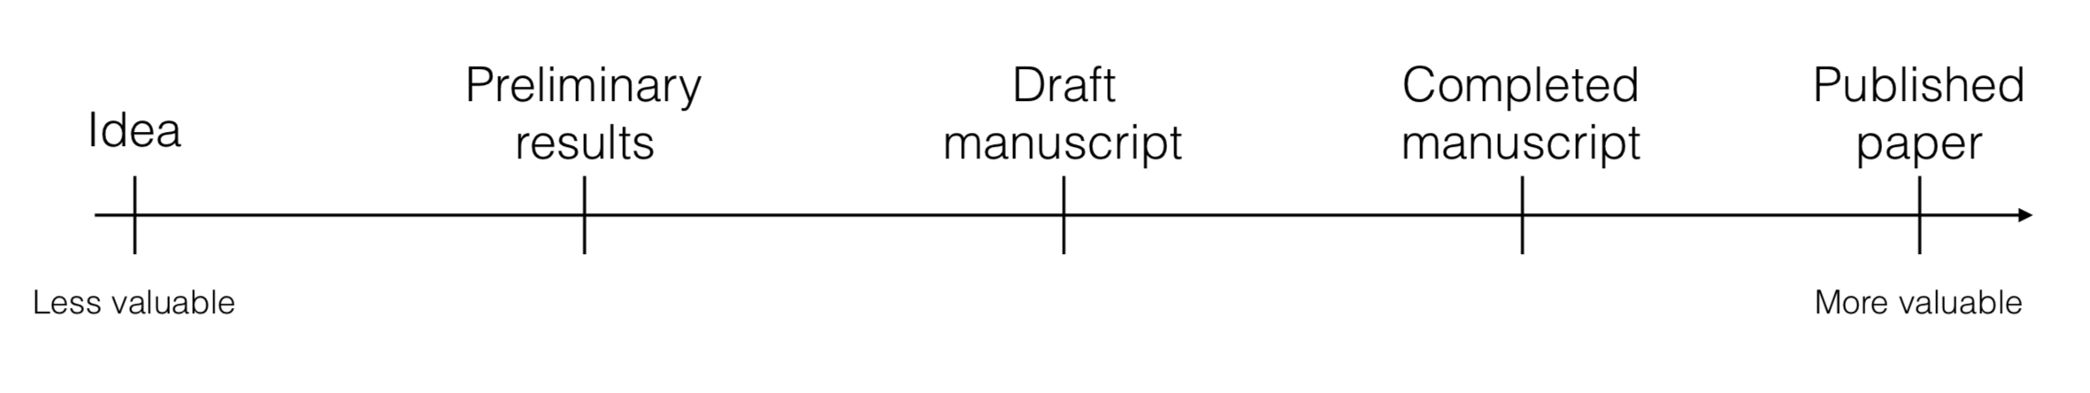
How we normally think of our work and goals

Slide 24
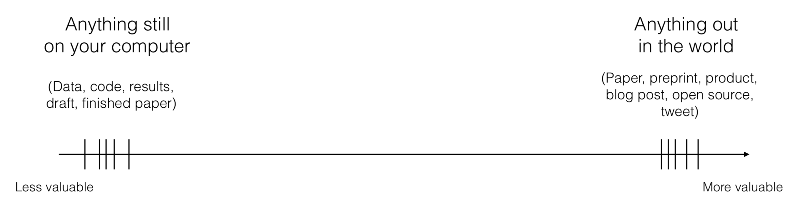
How we should think of our work and goals

Slide 25
Make your work available
Most journals allow you to post preprints online
(pre-typeset and pre-edited versions)
Consider posting working papers too!

Slide 26
Where?
Academia.edu & ResearchGate
Make it as easy as possible to access your stuff!
Your own website
Institutional repository
SocArXiv
Dropbox
Google Drive

Slide 27
Control your internet presence!
Tell people you exist
List yourself on existing websites
Show people who you are
Make your own website and use social media
Show people what you do
Show your in-progress and finished work

